Slide 1
Props, State and Context

Slide 2
Objectives
State in Class/Function Components
Passing Property Values
Context: an alternative to passing props

Slide 3
State
Each component can store its own local information in its “state”
Private and fully controlled by the component
Can be passed as props to children

Slide 4
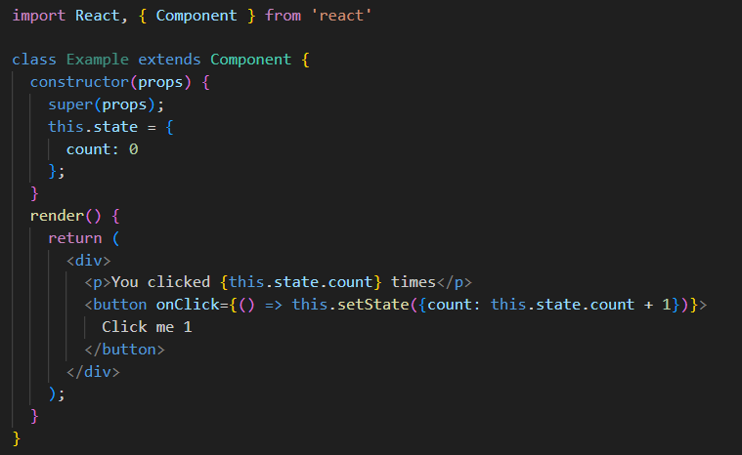
State in Class Components
State declared within the constructor
State should only be modified using setState()
Never do the following:
this.state.count = this.state.count +1 ;

Slide 5
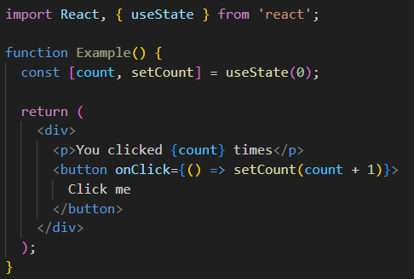
State in Function component
useState() allows you to use state in functional components : import React, { useState } from 'react’;

Slide 6
Reacting to Input with State
React provides a declarative way to manipulate the UI. Instead of manipulating individual pieces of the UI directly, you describe the different states that your component can be in, and switch between them in response to the user input. This is similar to how designers think about the UI.
How declarative UI compares to imperative
Thinking about UI declaratively

Slide 7
How declarative UI compares to imperative
When you design UI interactions, you probably think about how the UI changes in response to user actions. Consider a form that lets the user submit an answer:
When you type something into the form, the “Submit” button becomes enabled.
When you press “Submit”, both the form and the button become disabled, and a spinner appears.
If the network request succeeds, the form gets hidden, and the “Thank you” message appears.
If the network request fails, an error message appears, and the form becomes enabled again.
In imperative programming, the above corresponds directly to how you implement interaction. You have to write the exact instructions to manipulate the UI depending on what just happened.

Slide 8
Thinking about UI declaratively
You’ve seen how to implement a form imperatively above. To better understand how to think in React, you’ll walk through reimplementing this UI in React below:
Identify your component’s different visual states
Determine what triggers those state changes
Represent the state in memory using useState
Remove any non-essential state variables
Connect the event handlers to set the state

Slide 9
Choosing the State Structure
Structuring state well can make a difference between a component that is pleasant to modify and debug, and one that is a constant source of bugs. Here are some tips you should consider when structuring state:
Principles for structuring state
Avoid contradictions in state
Avoid redundant state
Avoid duplication in state
Avoid deeply nested state

Slide 10
Sharing State Between Components
Sometimes, you want the state of two components to always change together. To do it, remove state from both of them, move it to their closest common parent, and then pass it down to them via props. This is known as lifting state up, and it’s one of the most common things you will do writing React code.

Slide 11
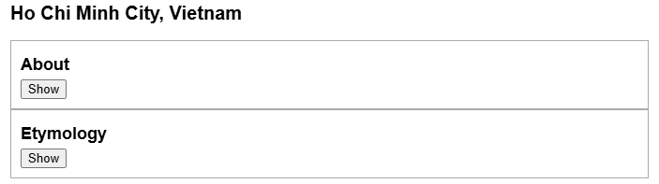
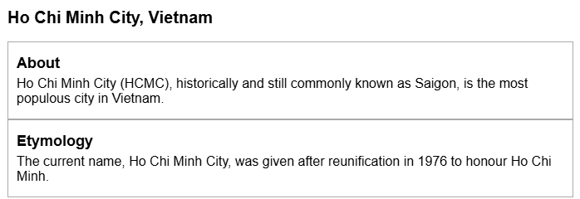
Lifting state up - Demo
import { useState } from 'react';
function Panel({ title, children }) {
const [isActive, setIsActive] = useState(false);
return (
<section className="panel">
<h3>{title}</h3>
{isActive ? (<p>{children}</p>) : (
<button onClick={() => setIsActive(true)}>
Show
</button>
)}
</section>
);
}
export default function Accordion() {
return (
<>
<h2>Ho Chi Minh City, Vietnam</h2>
<Panel title="About">
Ho Chi Minh City (HCMC), historically and still commonly known as Saigon, is the most populous city in Vietnam.
</Panel>
<Panel title="Etymology">
The current name, Ho Chi Minh City, was given after reunification in 1976 to honour Ho Chi Minh.
</Panel>
</>
);
}

Slide 12
Preserving and Resetting State
State is isolated between components. React keeps track of which state belongs to which component based on their place in the UI tree. You can control when to preserve state and when to reset it between re-renders.
State is tied to a position in the render tree
React builds render trees for the component structure in your UI.
When you give a component state, you might think the state “lives” inside the component. But the state is actually held inside React. React associates each piece of state it’s holding with the correct component by where that component sits in the render tree.
Same component at the same position preserves state
Different components at the same position reset state
Resetting state at the same position: By default, React preserves state of a component while it stays at the same position. Usually, this is exactly what you want, so it makes sense as the default behavior. But sometimes, you may want to reset a component’s state.

Slide 13
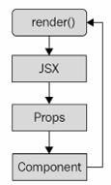
What are component Properties(Props)?
When React sees an element representing a user-defined component, it passes JSX attributes and children to this component as a single object. We call this object “props”.
Cannot modify props within the component
Props are Read-Only
The cycle of rendering components as properties

Slide 14
Props with Class Component
Define a class component.
Use the component and pass props to it
import React, { Component } from 'react'
export default class Profile extends Component {
render() {
return (
<div>Hello, {this.props.name}!</div>
)
}
}
const root = ReactDom.createRoot(document.getElementById('root'));
root.render(
<Profile name="GoF"></Profile>
);

Slide 15
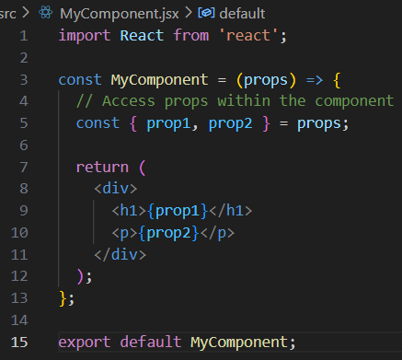
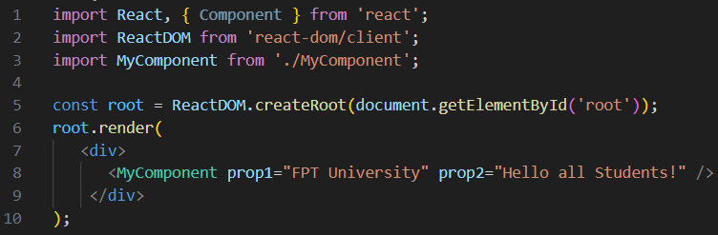

Props with Functional Component
Define a functional component
Use the component and pass props to it

Slide 16
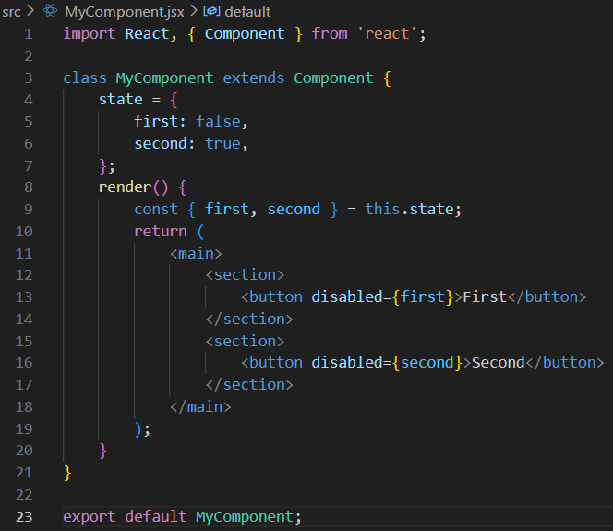
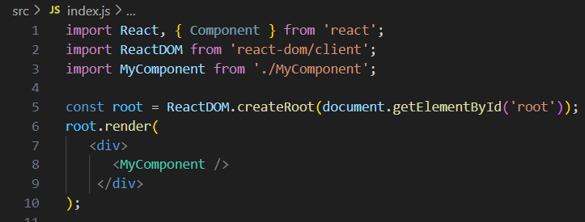
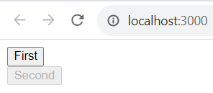
Setting initial component state
Setting initial component state for Class component

Slide 17
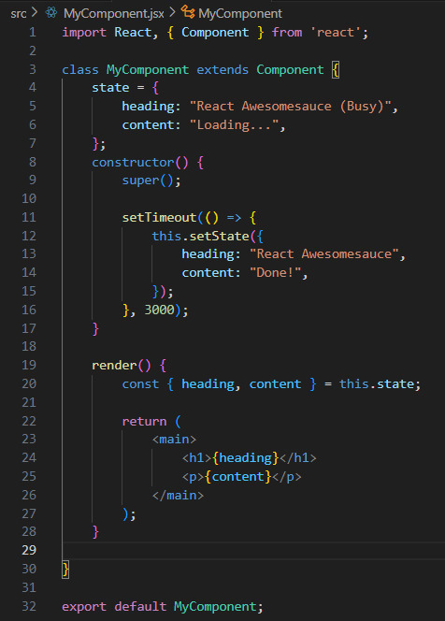
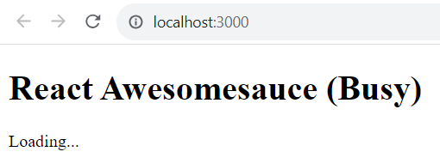
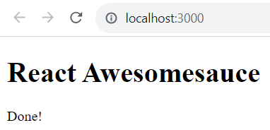
Setting initial component state
Creating component state

Slide 18
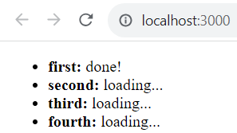
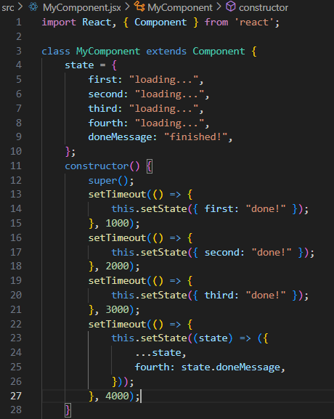
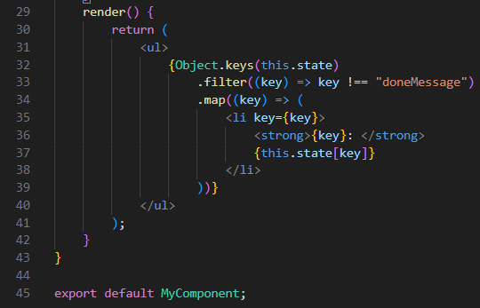
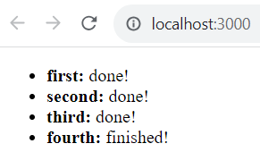
Setting component state – cont’d
Merging component state
The UI while data is loading
The UI when all async
operations are complete

Slide 19
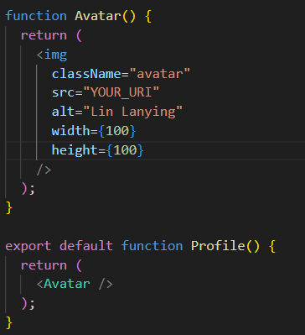

Passing Props to a Component – Demo 1
Familiar props: Props are the information that you pass to a JSX tag. For example, className, src, alt, width, and height are some of the props you can pass to an <img>:

Slide 20
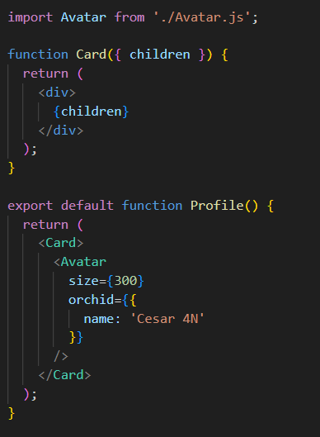
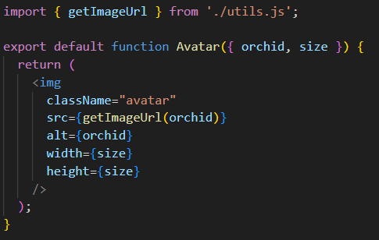
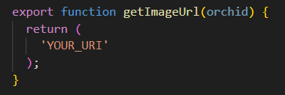

Passing Props to a Component – Demo 2
Passing props to a component
You can give Avatar some props in two steps:
Step 1: Pass props to the child component
Step 2: Read props inside the child component
App.js
Avatar.js
utils.js

Slide 21
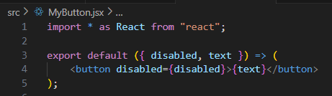
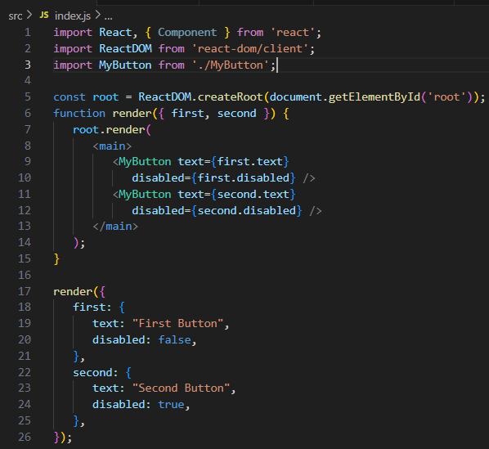
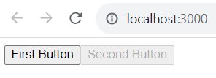
Stateless components
Pure functional components

Slide 22
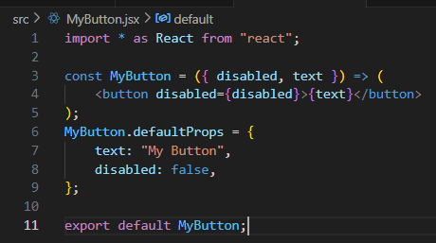
Stateless components – cont’d
Defaults in functional components

Slide 23
Container components
Don't couple data fetching with the component that renders the data.
The container is responsible for fetching the data and passing it to its child component.
It contains the component responsible for rendering the data.
For example, a container could substitute its child component. Or a child component could be used in a different container.

Slide 24
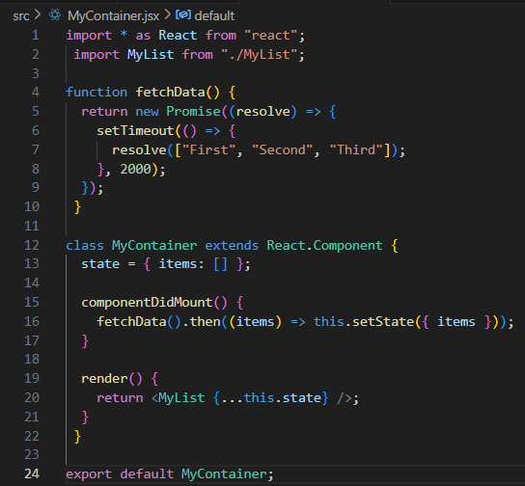
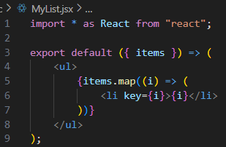
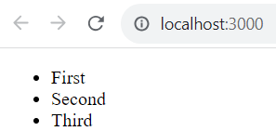
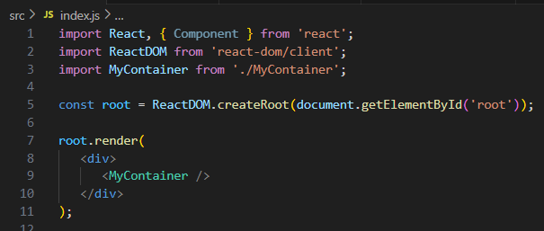
Container components – cont’d

Slide 25
Providing and consuming context
In React, when using contexts: providers and consumers.
A context provider creates data and makes sure that it's available to any React components.
A context consumer is a component that uses this data within the context.
Let's say that you have some application data that determines permissions for given application features. This data could be fetched from an API, or it could be hardcoded. In either case, the requirement is that you don't want to have to pass all of this permission data through the component tree.

Slide 26
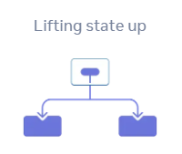
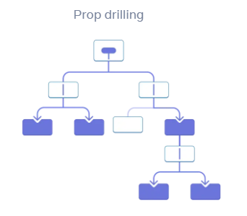
Context: an alternative to passing props
Passing props can become verbose and inconvenient when you need to pass some prop deeply through the tree, or if many components need the same prop.
The nearest common ancestor could be far removed from the components that need data, and lifting state up that high can lead to a situation called “prop drilling”

Slide 27
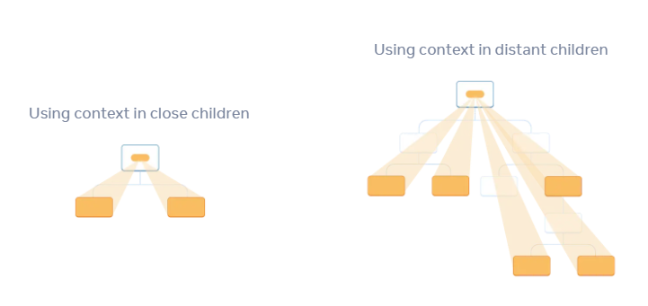
Context: an alternative to passing props (cont.)
Context lets a parent component provide data to the entire tree below it.
There are three steps for using context:
Create a context.
Use that context from the component that needs the data.
Provide that context from the component that specifies the data.

Slide 28
Summary
Concepts were introduced:
State in Class/Function Components
Passing Property Values
Context: an alternative to passing props

